Slide 1
Group - 5
Learning Management System
"Bridging the Gap Between Candidate Selection and Onboarding"
RISHIK VELPURI - 11507
PRASATH KUMAR R - 11513
SHAIK SIDDIK - 11520

Slide 2
1
Problem Statement
Introduction
2
Overview
3
Features
4
Modules
5
Technologies Used
6
Hardware/ Software Requirements

Slide 3

PROBLEM STATEMENT
To develop a Learning Management System bridging the gap between candidate selection and onboarding, aligning courses with strategic skills for enhanced preparation and sustained learning.

Slide 4
INTRODUCTION
Presenting our impactful Learning Management System (LMS) project tailored for Torry Harris Business Solutions, specifically designed to enhance the transition from candidate selection to onboarding. Our LMS delivers personalized courses aligned with strategic skills, revolutionizing the onboarding experience by boosting productivity of candidates and contributing to the growth of our organizational learning ecosystem.

Slide 5






FEATURES
Easy to access
Progress Tracking
Swot analysis
Adaptive Learning Assessment
Interactive Notes Taking
Feedback System

Slide 6
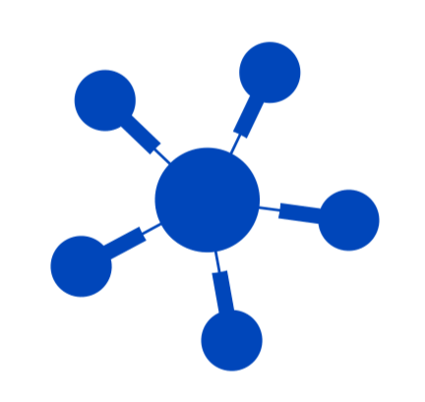
MODULES
User Management
Feedback
User Login, User Authentication and Authorization.
Grading and feedback mechanisms for enhancing learning experience.
1
5
Course Management
Progress Tracking
2
Allows administrators to create, edit, and organize courses based on organizational needs.
4
Tracking Learner Progress
by generating reports on completion and performance.
3
Assessment and Analysis
Creation of assessment and analysis

Slide 7
TECHNOLOGIES USED
Frontend
React JS
Backend
Spring Boot
Tech
Database
MySQL
DevOps
GIT, Jenkins and AWS

Slide 8
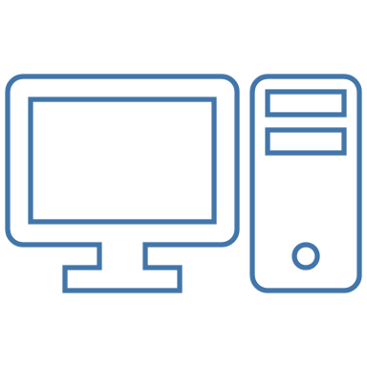
HARDWARE REQUIERMENT
Ec2 Instance Type : t2.medium
vCPUs: 2
Memory: 8 GB
Network Performance: Moderate
Hardware

Slide 9
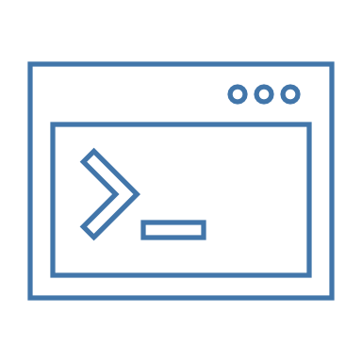
SOFTWARE REQUIERMENT
Development Tools :
Integrated development environment (IDE) (Visual Studio Code and IntelliJ) for Java development
Java Development Kit (JDK) (Java 17 or 21) for compiling and running Java code
Database management tool (MySQL Workbench) for managing MySQL databases.
Software
Deployment Tools :
Web application container (Tomcat 9 or 10) for deploying web applications
Continuous integration and continuous delivery (CI/CD) tool (Jenkins) for automating the build, test, and deployment process
Version control system (Git) for managing code changes and collaboration

Slide 10
THANK YOU！

